Slide 1


WEAVE AWS Tutorial
Charles Doutriaux, Dan Laney, Xiao Chen, Brian Gunnarson, Becky Haluska, Jorge Moreno, Lina Muryanto, Renee Olson, Jeremy White
Monday, October 14, 2024

Slide 2
Agenda
9:00: Buffer time to let everyone in
9:05: Charles: Welcome and WEAVE Intro
9:20: Starting up VMs, making sure everyone is good
9:30 Tutorial (see next slide for details)

Slide 3
Tutorial/Demo Script
Topic | Time | Presenter | Description
Problem Intro | ~10mn | Jeremy | Explain Raleigh-Taylor, Pyranda Python command line
Parameterize: Maestro | ~15mn | Jeremy | Explain Maestro to run many variations, run, status, cancel
UQ | ~5mn | Renee | Explain UQ and what we vary, PSUADE vs IBIS
Scaling: Merlin | ~10mn | Brian | Explain pgen, Merlin, samples concept, start workers
Provenance and Query: Sina | ~15mn | Becky | Sina + Bouncing Ball
Data Manipulation: Kosh | ~10mn | Jorge | Start_here notebook
UQ Results | ~10mn | Xiao | Show script using Sina and Kosh then results for our study

Slide 4




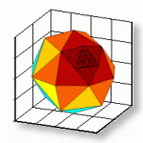
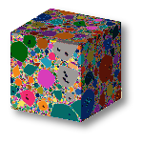
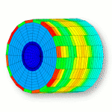
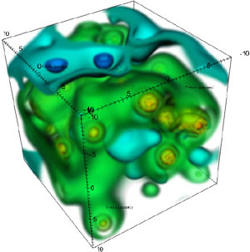


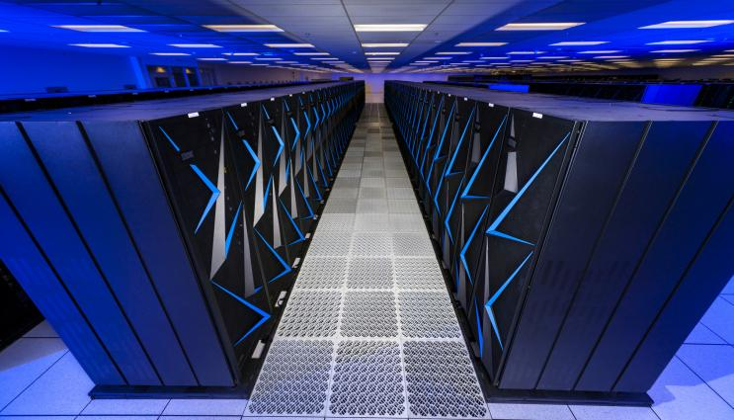
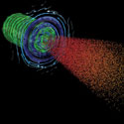
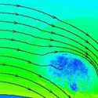
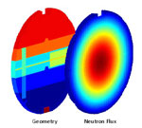
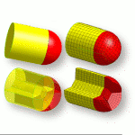
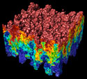
Vision
Notes:
Science on one end
WSC end mission
LC/Hardware on the other
Or experiments
Single problem (loop over sim/post-analysis)
WF as an enabler for Scientists and for LC

Slide 5

The Data Tsunami
Current applications are data hungry, eg.
Machine Learning (ML)
Optimization
Uncertainty Quantification (UQ)
Experimental Design
E.g: today we will run a UQ study, using the pyranda simulation tool (https://github.com/LLNL/pyranda)
WEAVE tools will be used to facilitate large scale data generation, manipulation, provenance, coordination, etc.

Slide 6
Our Vision: enhance user productivity and scientific quality through common infrastructure and tool integration
Decrease human time from the posing of a problem to its answer
Enable our users to take advantage of exascale computers like El Capitan
Smooth integration and interoperation of problem setup, simulation management, and analysis tools
Enable and support code-agnostic inputs and outputs for WSC/CP applications
Allow users to work at a higher level than a “Sea of Files”
But let them “see their files!”
Provide documentation and examples to enable “tool builders” in the user community to leverage a common workflow toolkit

Slide 7







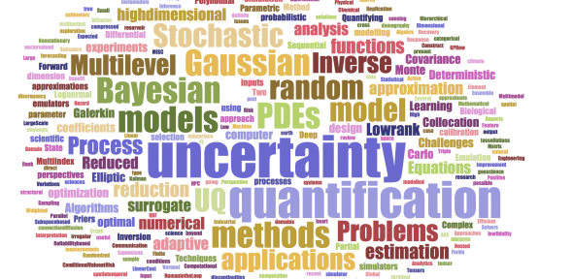


WEAVE Tools Components
PyDV
Sina
WEAVE Tools have been under dev and in-use for many years
Sina/Maestro/Merlin 2016 (ATDM), IBIS/Trata (ASCI ERA), Kosh 2019 (Vidya)
Notes:
Different areas different techs but similar problems
Let scientist focus on Science
Let LC focus on hardware and super computing

Slide 8


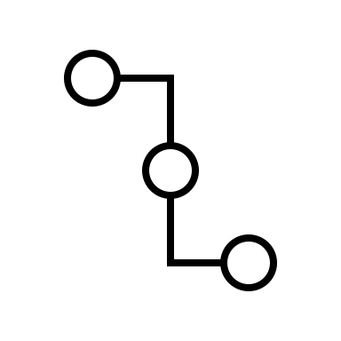




Orchestration: Maestro
Maestro aims to enable reproducible computational science following the model set by the experimental disciplines
Computational
Process
Parameter 1
Process 1
User #1
Parameter 2
Process 2
. . .
Analytics
. . .
User #2
User #3
Parameter n
Process n
High Performance Compute
Data
Maestro’s vision is to become a toolchain and ecosystem of tools adaptable to user’s needs

Slide 9
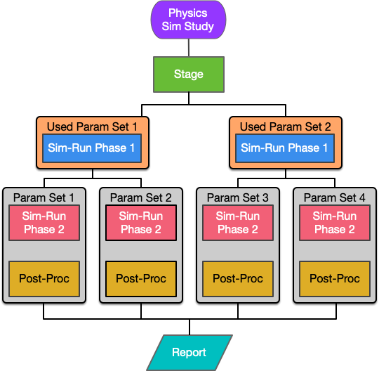
Having a complete, concrete, repeatable process, Maestro can run experiments with it by inflating the graph with parameters
YAML Specification
study:
...
- name: sim-run
description: run the simulation.
run:
cmd: |
cp $(stage.workspace)/$(INPUT_FILE) .
$(LAUNCHER) $(SIM_CODE)/sim_exe -in $(INPUT_FILE) –p 4 –res $(RES)
procs: 4
nodes: 1
walltime: "00:10:00”
...
global.parameters:
# Resolutions to run
RES:
values : [1, 2, 3]
label : RES.%%
...
Notes:
Maestro handles inflation of abstract task graph, applying parameters to each step for a concrete set of experiments to run

Slide 10
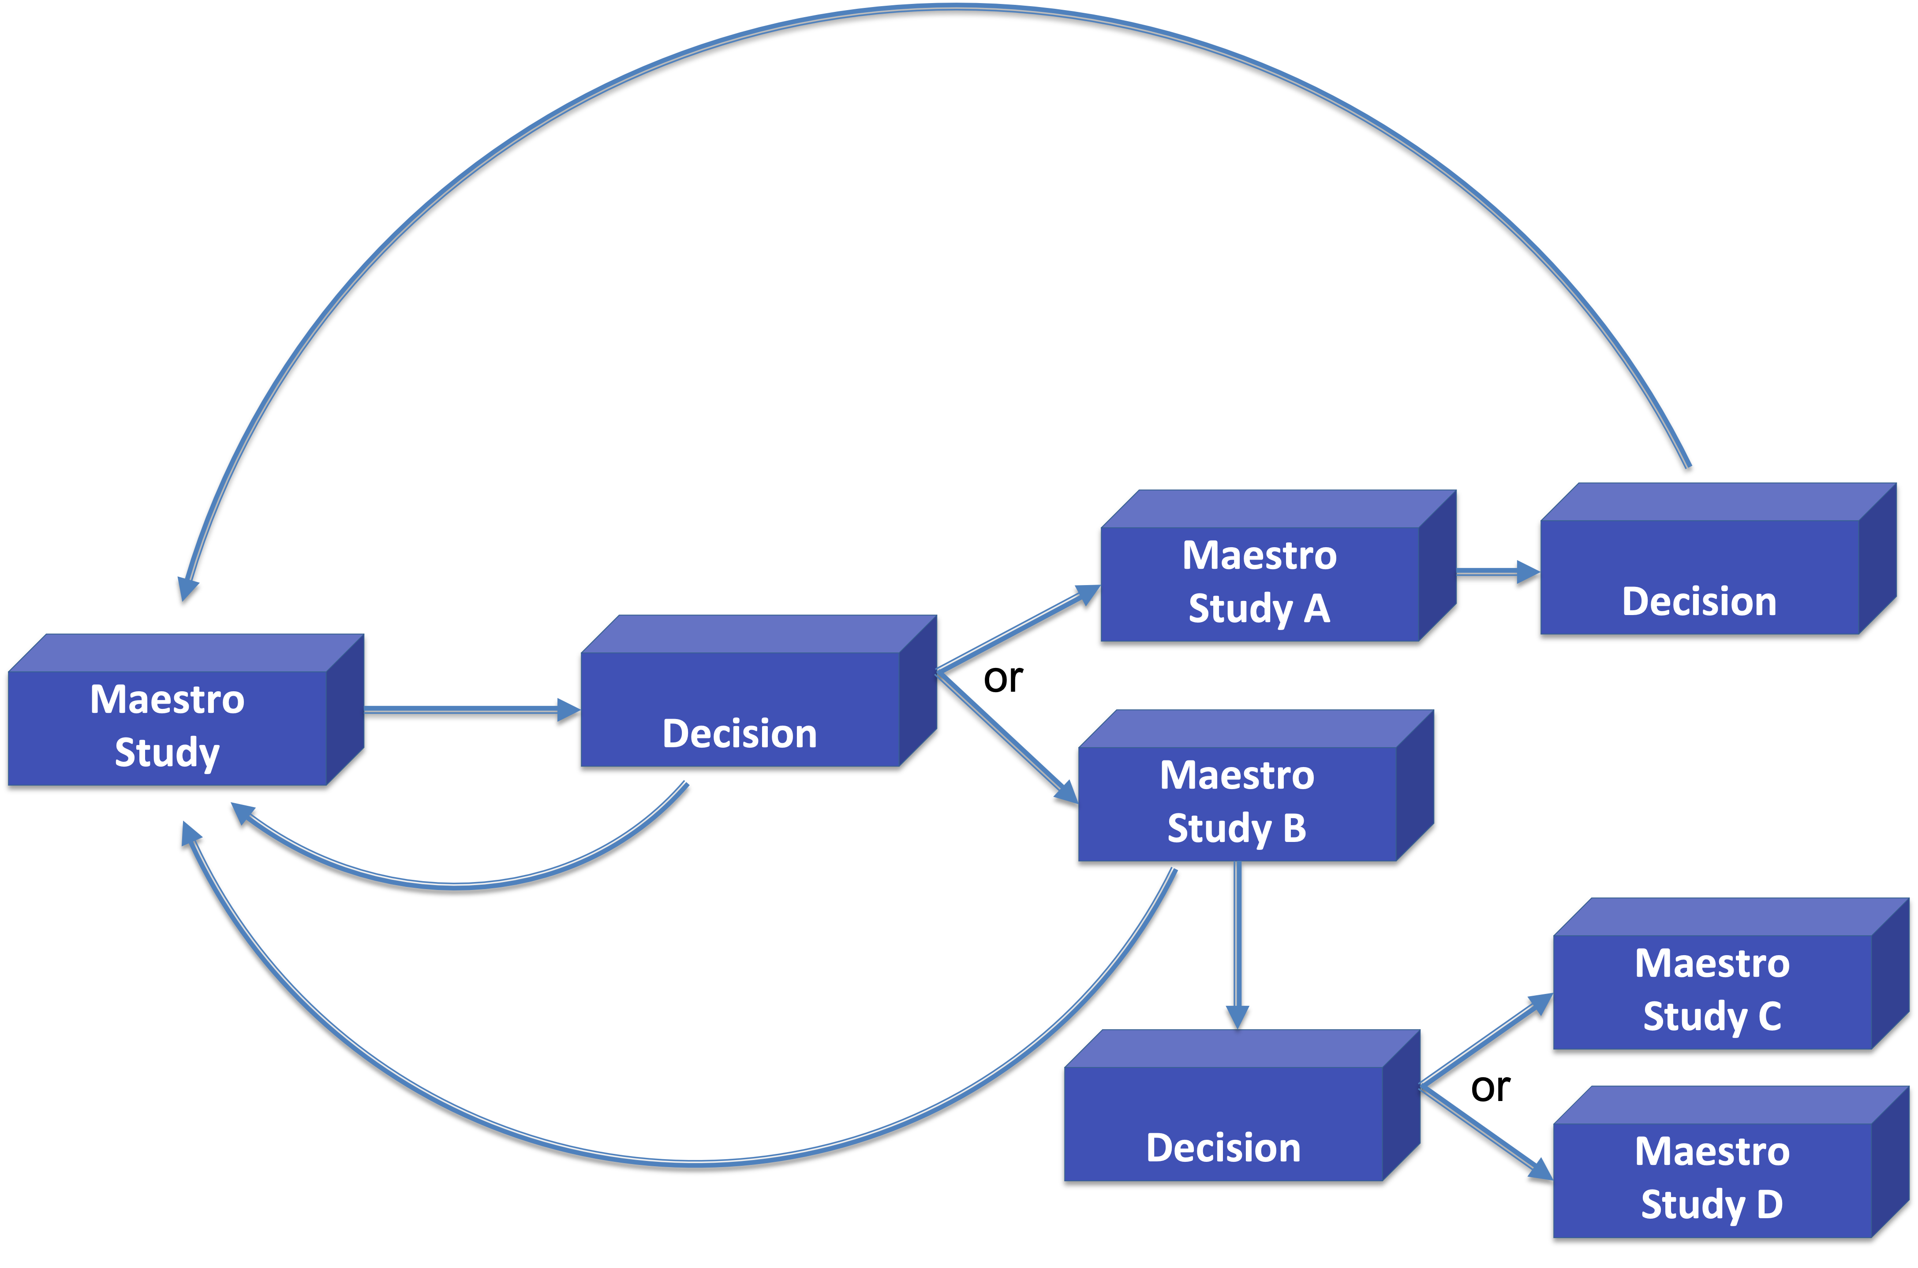
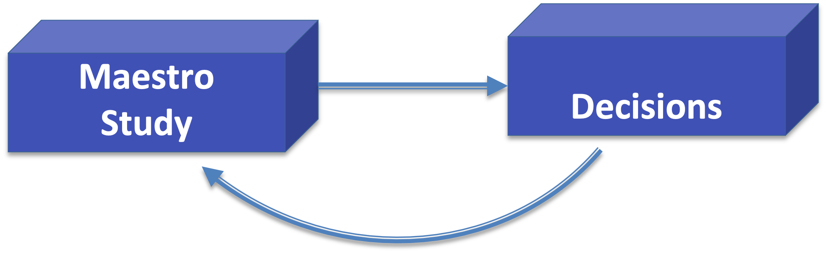
Vision is to be a tool chain/ecosystem of orchestration tools for building complex workflows
Two such examples already:
Merlin: exploring an implementation of distributed task queues and recursive type iterative workflows
Encorewf: adds outer layer with explicit decision-making steps and tracking of per-study iterations.
Simple single study spec based iterative and optimization type workflows
Chain disparate Maestro study spec’s for more complex multi-phase workflows
Complex multi-phase iteration/optimization
Simple Iteration/Optimization

Slide 11
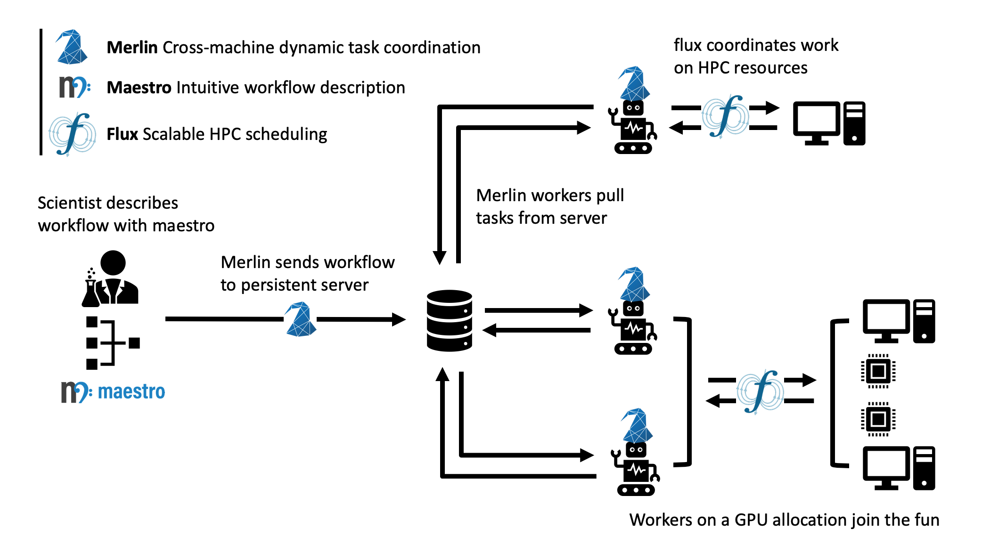
Merlin runs its’ workflows using a producer/consumer model
Merlin uses the same YAML spec format as Maestro
Central-server based system
Two commands for the producer/consumer model
HPC scheduling via Flux, Slurm, LSF, or PBS (untested w/ PBS so be wary)
Merlin run-workers
Merlin run

Slide 12
Merlin allows for iterative workflow runs via recursive studies
env:
variables:
ITER: 1
MAX_ITER: 10
PYTHON: <path to python>
POST_PROC: <path to cumulative post processing script>
ITER_OUTPUT: <path to iteration outputs>
study:
<other steps>
- name: iterate
description: run another iteration or post process all iterations
run:
cmd: |
if [ $(ITER) -ge $(MAX_ITER) ] ; then
echo "done"
$(PYTHON) $(POST_PROC) $(ITER_OUTPUT)/iter_*_results.json
else
next_iter=$(ITER)
((next_iter=next_iter+1))
echo "Starting iteration " $next_iter
cd $(SPECROOT)
merlin run $(SPECROOT)/iterative_demo.yaml --vars ITER=$next_iter
fi
task_queue: iterative_queue
Allows for a base-case where you can do whatever is needed with the results of your iterative runs
E.g. running a post-processing script over all result files generated
Once workers are started, they’ll keep pulling tasks from their queues until they’re stopped
This allows workers to keep completing work even if the work is queued from a different run of a study
i.e. no need to start the workers a second time

Slide 13
Trata is a sampling package designed to allow users to explore a parameter space by generating sample points
Trata includes the following modules:
composite_samples
sampler
adaptive_sampler
kosh_sampler
Trata samples can be used with IBIS to better understand parameter variance and model prediction uncertainty
Official Use Only

Slide 14
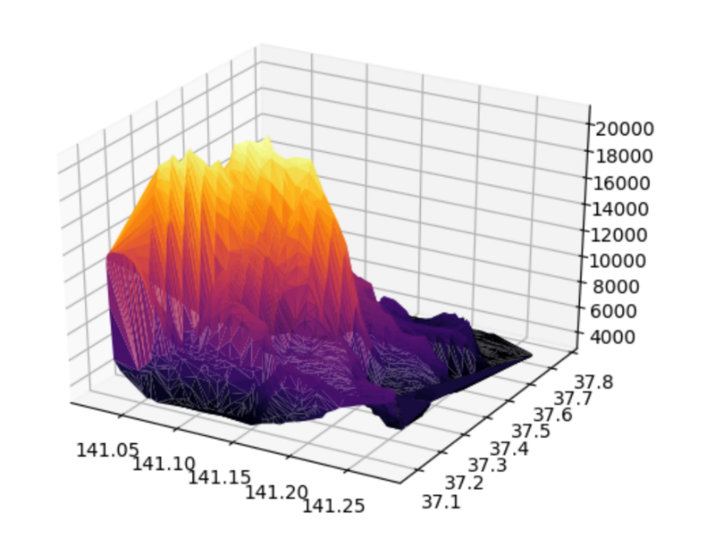

WEAVE’s Sina Tool Sina handles data munging
Created to increase the availability of simulation data with minimal user effort
Integrates directly with codes to pull data
Outputs data into an easily-automated format
Provides tooling to render this data interactive (through Jupyter) and easily processed (through a Python API) across one run or many
Intended especially for use with run metadata, allowing users to easily and efficiently find simulation runs that match their criteria.
Metadata
Curves
Code
sina.json
Setup
Outputs

Slide 15

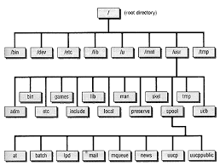




WEAVE’s Kosh Tool Why use Kosh?
Kosh is built on top of Sina:
Kosh can load a Sina store. Sina can query a Kosh store.
Sina is being integrated with Physics Codes.
Lots of Data and Metadata Accessible out of the box.
Multiple Database backends
Includes LC’s Kubernetes deployed MySQL and Cassandra DB.
Optimized query search
Kosh has unique features:
Kosh can access and process data
in a consistent fashion, decoupled
from data format and location via
"loaders“
"transformers“
"operators
Store
Dataset
types={“hdf5”:[“numpy”,]}
def extract()
def list_features()
Data Source
__id__: uuid
project: Tutorials
problem: 101
date_created
author
parameter_1
Loader
uri: /p/lscratch/…/file
mime_type: hdf5
parameter_A:
Feature

Slide 16
IBIS
IBIS (Interactive Bayesian Inference and Sensitivity) is designed to allow users to generate statistical models after physics simulations have run to completion
These models can be used to predict the results of future simulation runs, and to perform sensitivity and uncertainty quantification analyses
Ibis comes from the Egyptian word for the long-legged wading bird associated with the ancient Egyptian deity Thoth, god of science and magic
Official Use Only

Slide 17
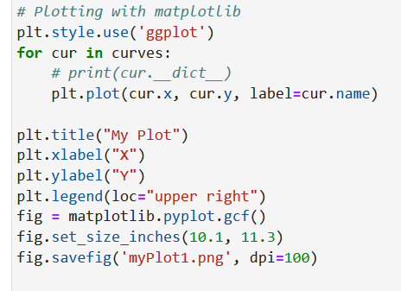
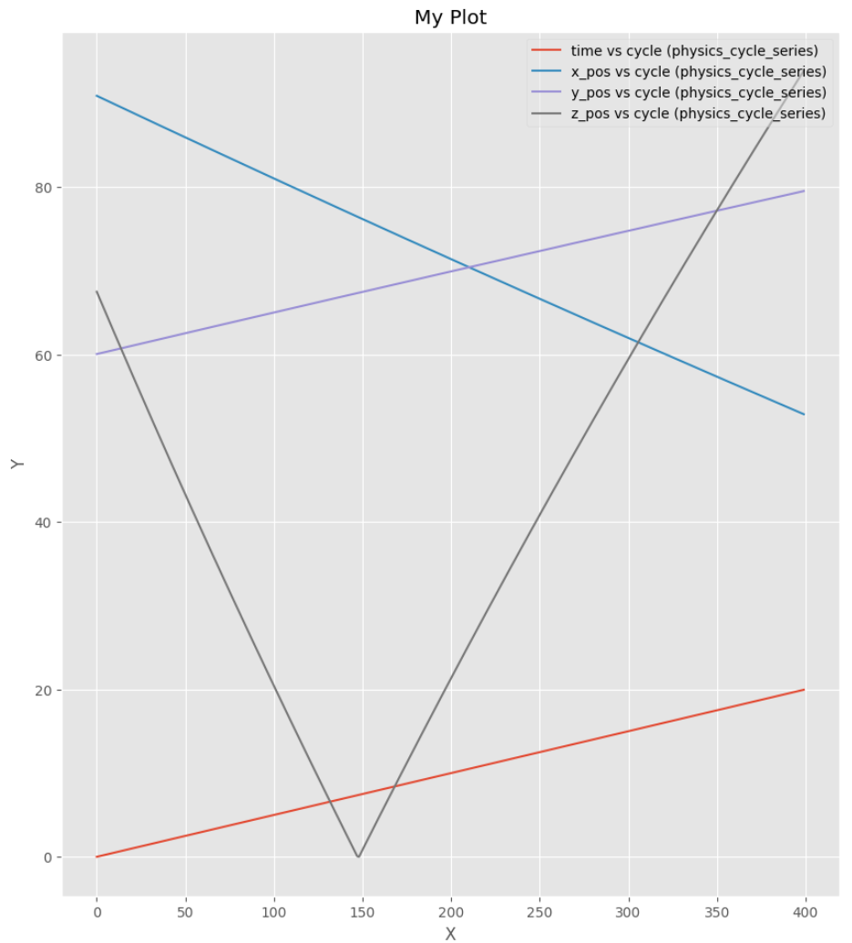
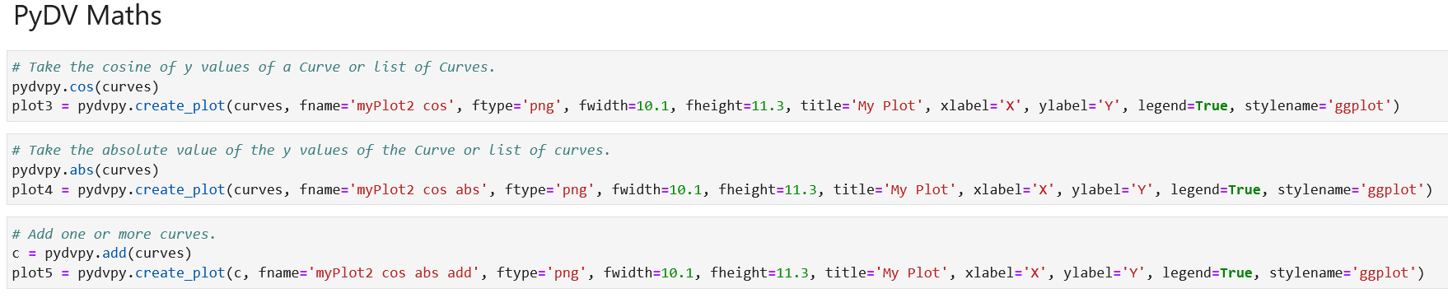
PyDV
Python Data Visualizer (PyDV) allows the presentation, manipulation, and analysis of 1D data sets, i.e. (x,y) pairs
Uses NumPy to manipulate data
Plotting capabilities are built on top of Matplotlib
Eliminates the need for a user to write tedious lines of code for mathematical and plotting operations

Slide 18
Tutorial
ssh into your instance: ssh -i aws-weave-2.pem ec2-user@ec2-xxx-xxx-xxx-xxx.us-west-1.compute.amazonaws.com
Run the setup script using your dedicated IP:
source ./setup_instance.bash
Copy/paste the link ( something like http://ec2-xxx-xxx-xxx-xxx.us-west-1.compute.amazonaws.com:8888/lab
If you messed do not worry, simply run:
./clean_and_reset.bash
We recommend you use the jupyter lab terminal but you can also follow in the terminal.

Slide 19
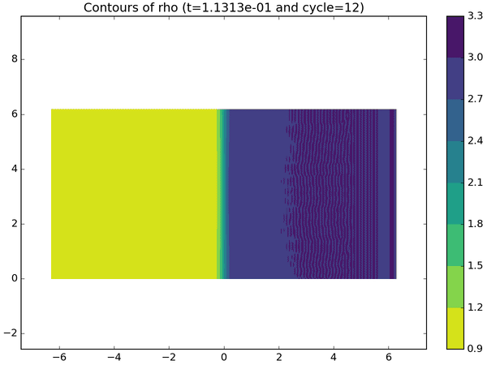

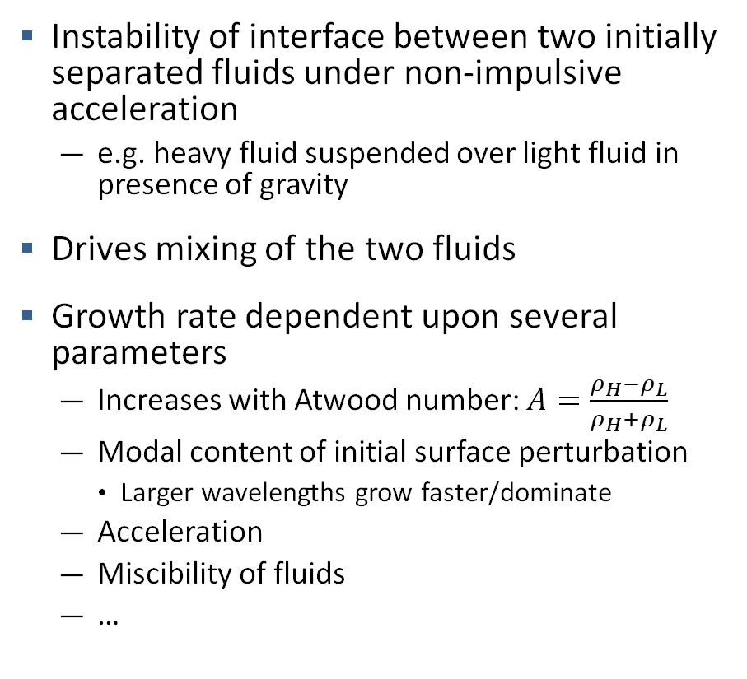
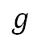
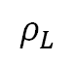
Rayleigh-Taylor Instability
Instability of interface between two initially separated fluids under non-impulsive acceleration
e.g. heavy fluid suspended over light fluid in presence of gravity
Drives mixing of the two fluids
Growth rate dependent upon several parameters
Increases with Atwood number: $A=\frac{ρ_{H}−ρ_{L}}{ρ_{H}+ρ_{L}}$
Modal content of initial surface perturbation
Larger wavelengths grow faster/dominate
Acceleration
Miscibility of fluids
…
$$ρ_{H}$$
$$g$$
$$ρ_{L}$$

Slide 20
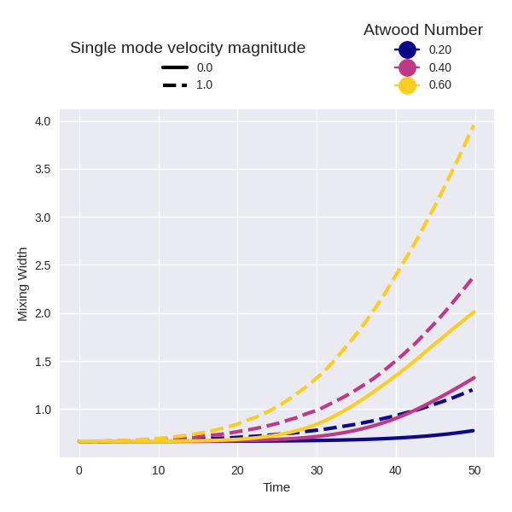
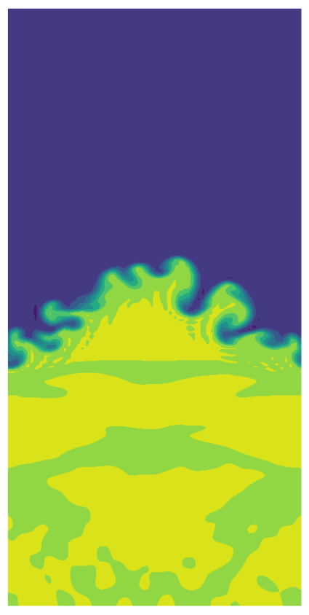
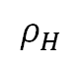
Use pyranda to simulate the effects of some of these factors
pyranda
high order finite difference solver for arbitrary hyperbolic PDE systems
python driven, mpi parallel fortran solver
Rayleigh-Taylor model
Driver: rayleigh_taylor.py
Parameters
atwood-number: density ratio
seed: seed for randomly generated initial perturbations
velocity-modes: single mode freq
velocity-magnitude: multiplier for single mode initial velocity
random-velocity-magnitude: multiplier for random initial velocity
T = 50
$$ρ_{H}$$
Mixing
Width
$$ρ_{L}$$

Slide 21
Define the experimental process using Maestro’s minimal workflow language
Tokens:
Turn your workflow description into a generic template
Syntax: $(TOKEN_NAME)
cmd:
Define how your process runs
Written in bash
depends:
List of prior step names that must be executed first
$(LAUNCHER) token used inside steps to invoke executables
Slurm variant expands to: srun –n …
YAML Specification
Workflow Process
description:
name: rayleigh_taylor_overview_pyranda
description: |
A study for running Rayleigh-Taylor mixing simulations using pyranda. This is a small
experiment of fast running models demonstrating Atwood number effects.
study:
- name: run-pyranda
description: Run pyranda
run:
cmd: |
$(LAUNCHER) $(PYTHON) $(RAYLEIGH_TAYLOR_MODEL) --dim $(DIM) \
--atwood-number $(ATWOOD) \
--num-points $(NPTS) \
--velocity-magnitude $(VELOCITY_MAGNITUDE) \
--random-velocity-magnitude $(RANVEL) \
… # REMAINING ARGS OMITTED
- name: post-process-all
description: post processes all simulations into a summary plot
run:
cmd: |
echo "Parent workspace: $(run-pyranda.workspace)"
$(PYTHON) $(OVERVIEW_PLOTTER) --headless $(run-pyranda.workspace)/*
depends: [run-pyranda_*]
Notes:
Maestro handles inflation of abstract task graph, applying parameters to each step for a concrete set of experiments to run

Slide 22
Parameter sets are the experiments to run through our process
YAML Specification
Workflow Process
Expanded Process of Experiments
...
study:
- name: run-pyranda
description: Run pyranda
run:
cmd: |
…
- name: post-process-all
description: post processes all simulations into a summary plot
run:
cmd: |
…
...
global.parameters:
VELOCITY_MAGNITUDE:
values : ["0.0", "1.0", "0.0", "1.0", "0.0", "1.0"]
label : VEL.%%
SEED:
values : [ 17, 17, 17, 17, 17, 17]
label : SEED.%%
ATWOOD:
values : ["0.2", "0.2", "0.4", "0.4", "0.6", "0.6"]
label : ATWOOD.%%
...
Unique Parameter Combinations Determine Graph Connectivity
Notes:
Maestro handles inflation of abstract task graph, applying parameters to each step for a concrete set of experiments to run

Slide 23
Now lets add some more steps to do Uncertainty Quantification of the Rayleigh-Taylor model
YAML Specification
study:
- name: run-pyranda-uq
description: Run pyranda
run:
cmd: |
…
- name: post-process-simulation
description: Post processes individual simulation outputs
run:
cmd: |
…
depends: [run-pyranda]
- name: plot-all
description: post processes all simulations into a summary plot
run:
cmd: |
…
depends: [post-process-simulation_*]
- name: bayesian-ibis
description: Bayesian inference using ibis
run:
cmd: |
…
depends: [plot-all]
Notes:
Maestro handles inflation of abstract task graph, applying parameters to each step for a concrete set of experiments to run

Slide 24
Pyranda Uncertainty Quantification (UQ) Study
Goal: Understand the uncertainty or variability of the mixing width in fluid mixing situations
Information sources:
Physics equations in Pyranda simulation
Real world experimental data
Use Bayesian inference to update our knowledge of fluid mixing width with experimental data
UQ Study
Generate a lot of data with simulation (Trata and Maestro/Merlin)
Fit surrogate model to simulation data for faster inference
Use tools (IBIS and Psuade) to do Bayesian Inference and understand input/output variance
Because our instance are not really big it could take a long time to generate all the data using Maestro. But with Merlin we can take advantage of all of our instances and distribute the work across them. We setup a NFS shared directory for all the instances to write to a common place.

Slide 25
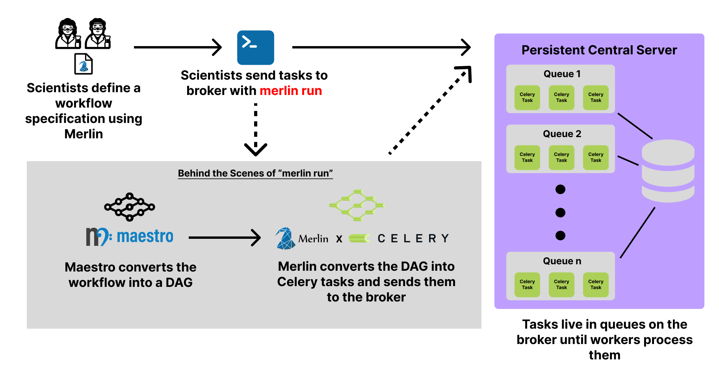
Merlin Run

Slide 26
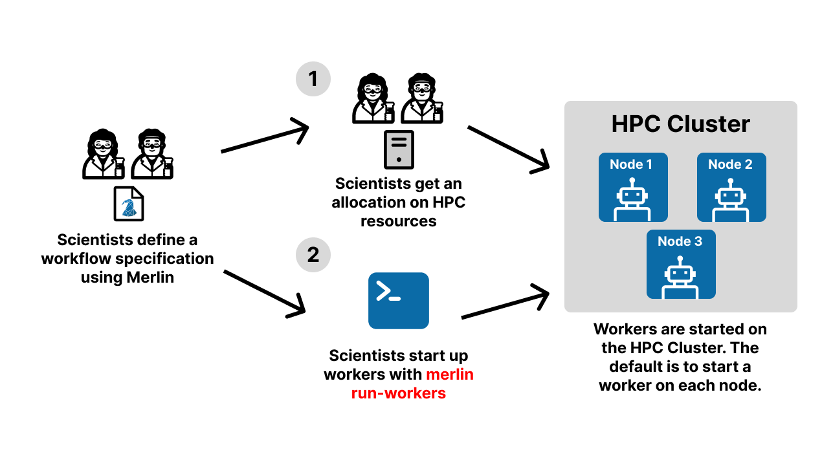
Merlin Run-Workers

Slide 27
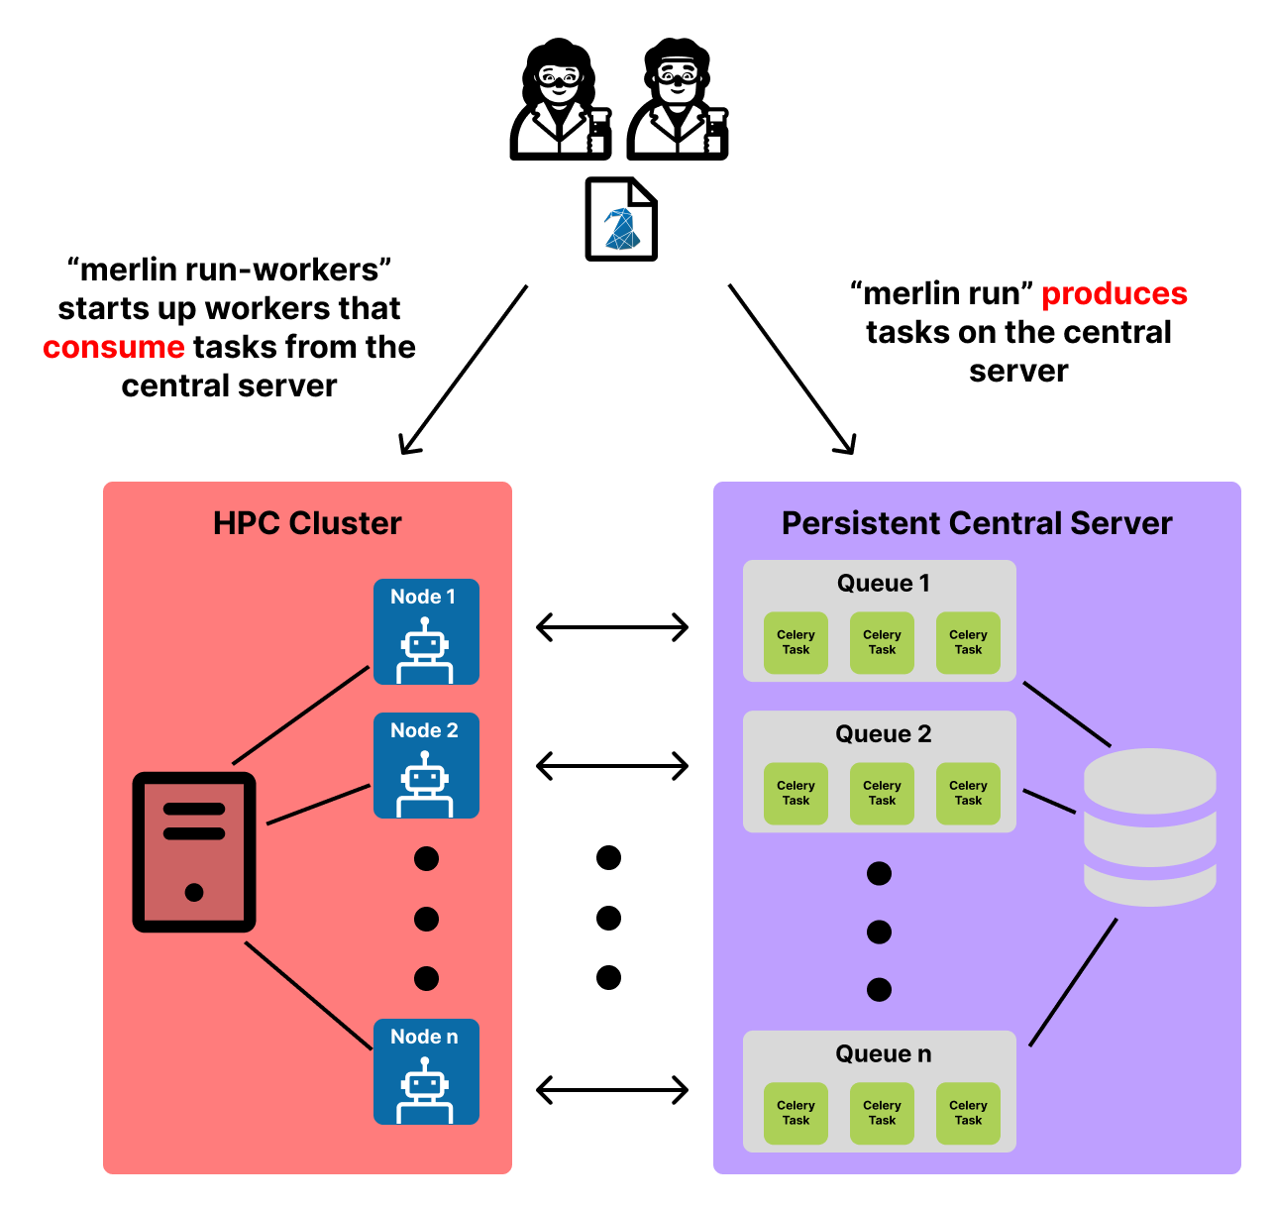
Full Merlin Producer-Consumer Model

Slide 28
Live Demo
Let’s move over to the AWS instance for a live demo of the UQ study with Merlin
cd ~/git/weave-demos/CZ/pyranda_rayleigh_taylor

Slide 29
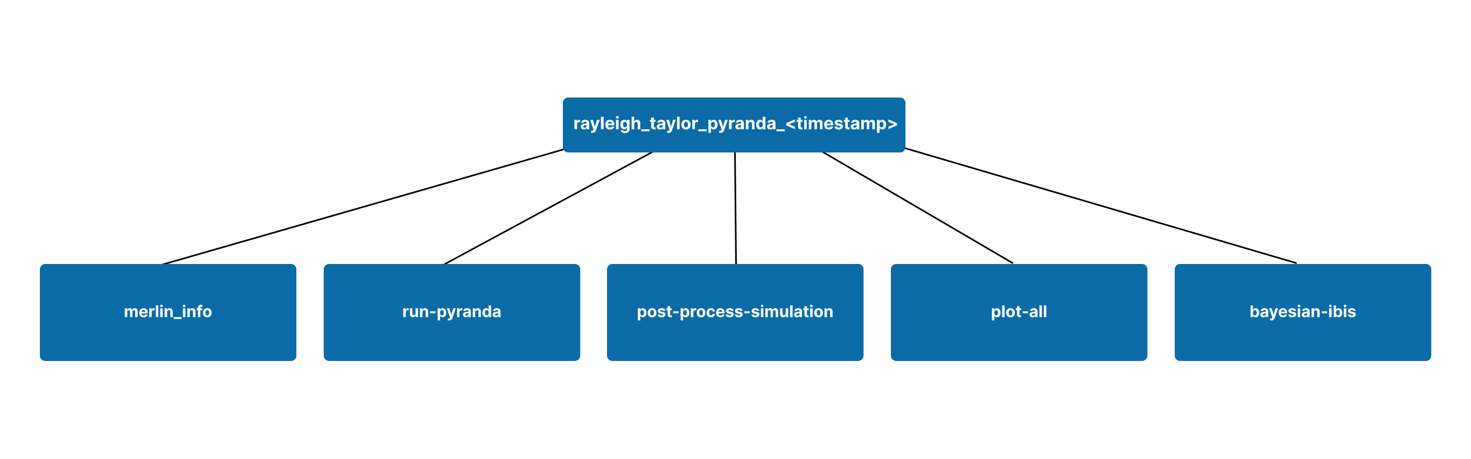
Merlin Output Directory
At the top level of the output workspace, you’ll see a `merlin_info` directory as well as a subdirectory for each step of the workflow
`merlin_info` houses the spec file that was ran for this study, as well as our samples

Slide 30
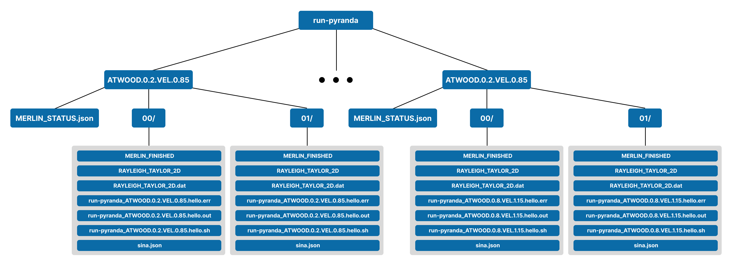
Merlin Output Directory pt 2
Every sample (00 and 01 directories) will run for every parameter set

Slide 31
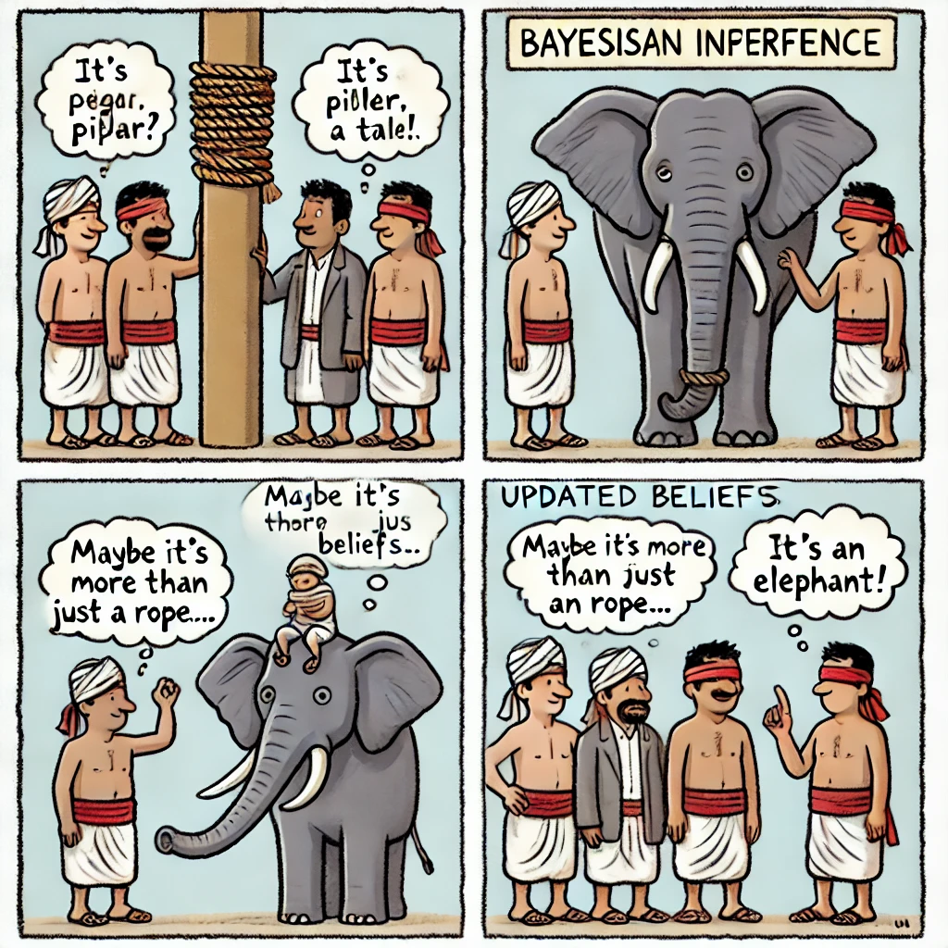
Blind men and the elephant: what is Bayesian inference?
Initial Beliefs: Blind men never sees a elephant before, having initial beliefs (priors) based on existing evidence (e.g., a leg feels like a pillar, a trunk like a rope)
Bayesian Inference: Blind men touch different parts of the elephant, gathering more information, they start questioning their initial beliefs based on experiments
Updated Beliefs: With more evidence and experiments, their beliefs evolve, leading to a more accurate understanding—the realization that it’s more than a rope.
Posteriors: The final, updated belief after considering all available evidence to figure it out that it might be an elephant.
priors
Posteriors

Slide 32

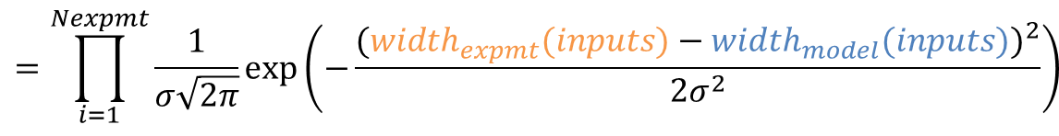

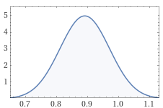
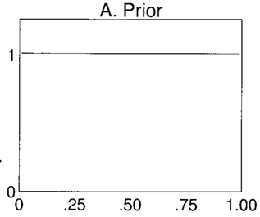
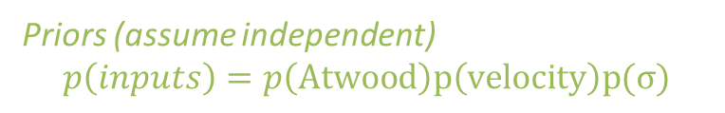
We can learn about experimental inputs through Bayesian inference
MCMC Sampling with IBIS and Psuade
Priors
Likelihood
Posterior
Atwood number
Atwood number
Experimental data mix width
Velocity Magnitude
Velocity magnitude
σ
σ
Gaussain Process Model mix width

Slide 33
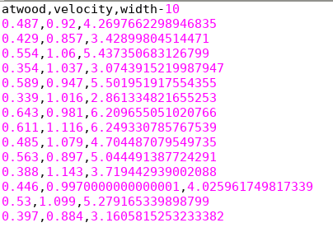
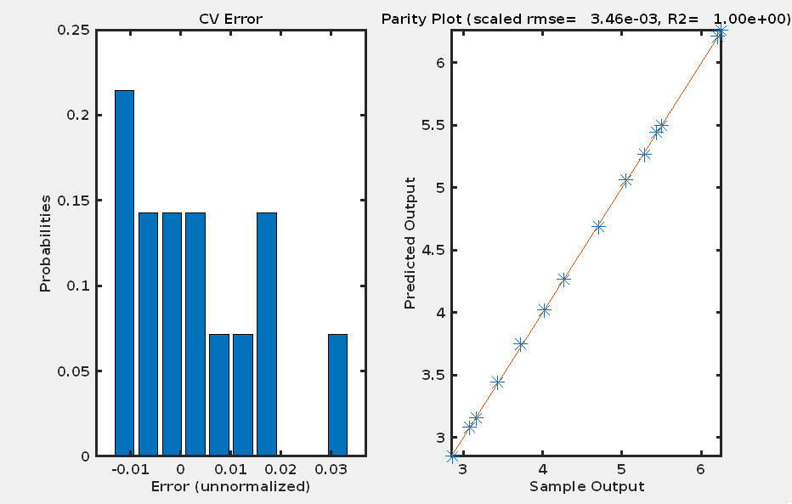
Training data is fitted by a selected Gaussian process in PSUADE

Slide 34
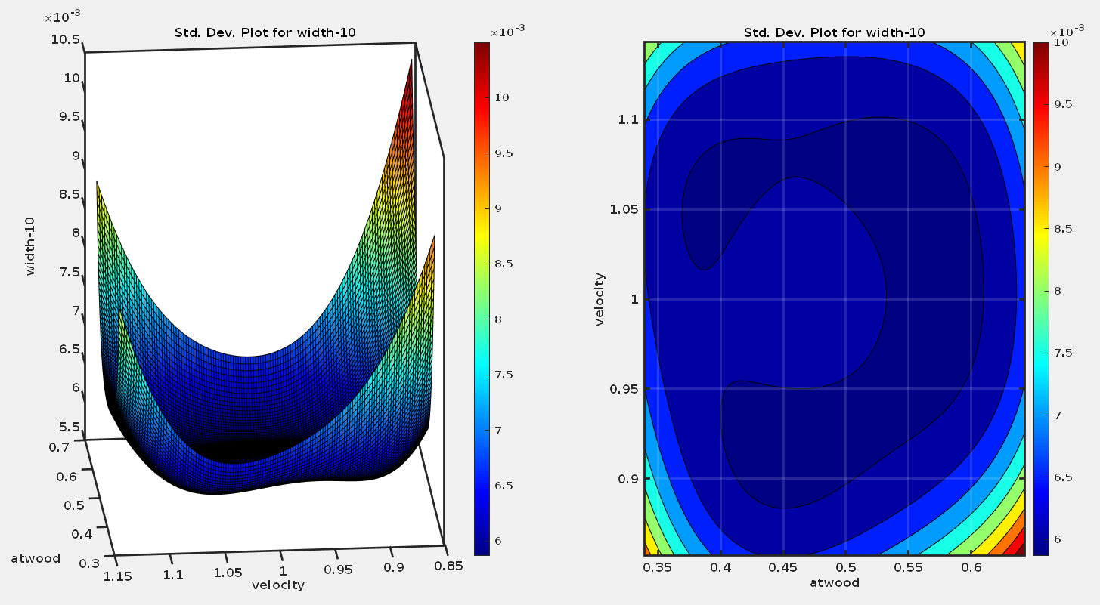
The visualization of the errors of the selected Gaussian process

Slide 35
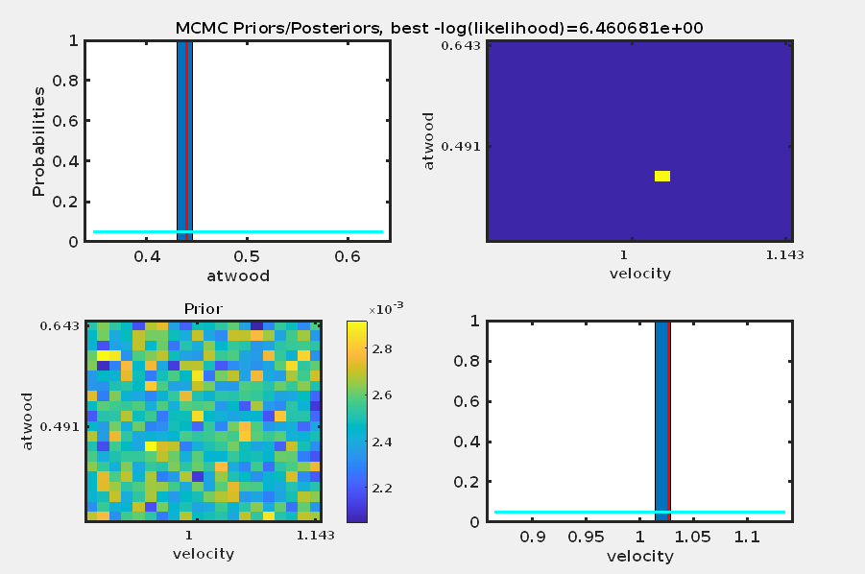
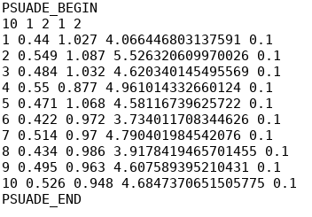
Bayesian inference based on prior information and high-resolution experiments to reach to a better belief and posterior

Slide 36
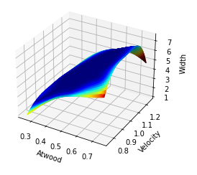
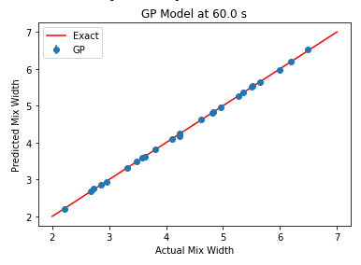
Gaussian process model fit with scikit-learn
GP Predictions for Mixing Width
Leave-One-Out Cross Validation

Slide 37
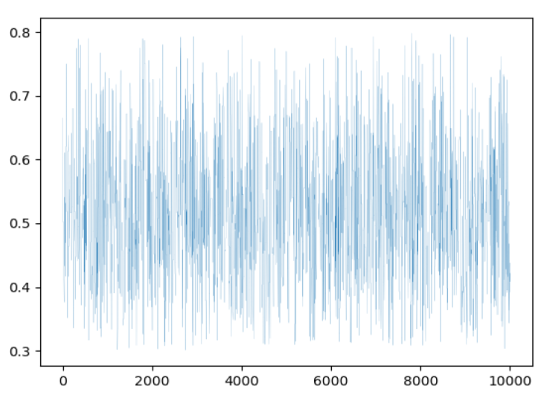
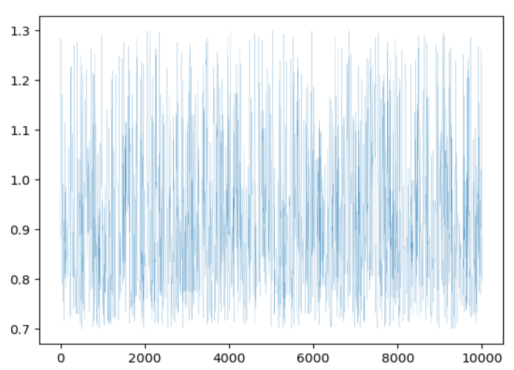
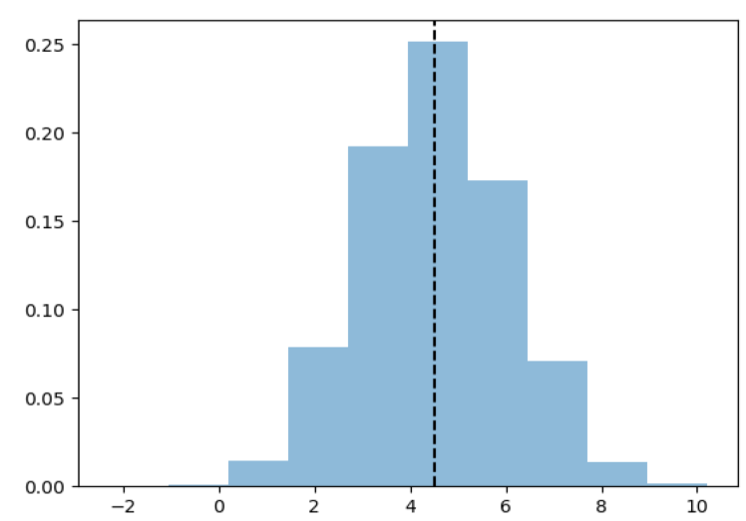
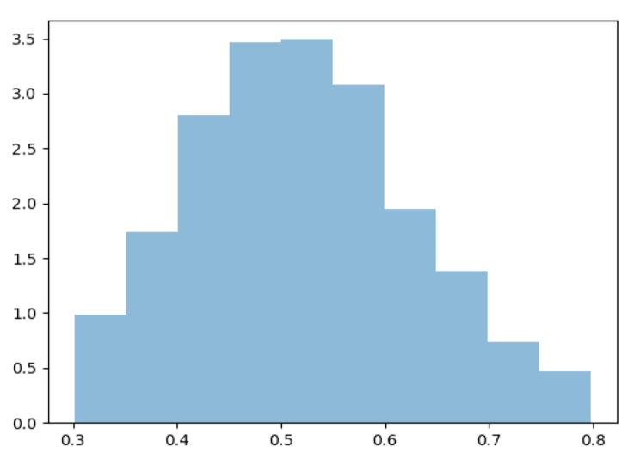
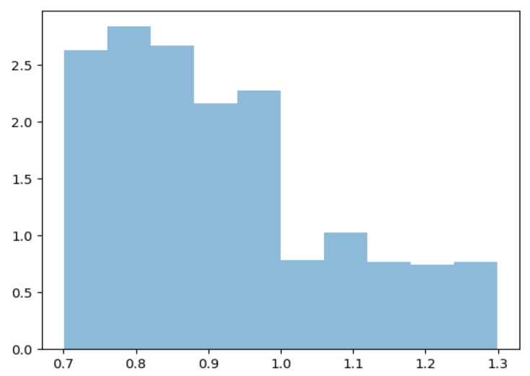
Bayesian inference results with IBIS
Atwood number
Velocity-magnitude
Posterior Distribution for Mix Width
Trace plot
Trace plot
Informed distribution
Informed distribution

Slide 38




Bye
Package | Anywhere | QR | At LC (CZ/RZ/SCF)
WEAVE | https://llnl-weave.readthedocs.io/en/latest/ |  | https://lc.llnl.gov/weave
Maestro | https://maestrowf.readthedocs.io/en/latest/ |  | https://lc.llnl.gov/weave/maestrowf/html/index.html
Merlin | https://merlin.readthedocs.io/en/latest/ |  | https://lc.llnl.gov/weave/merlin/html/index.html
Sina |  |  | https://lc.llnl.gov/weave/Sina/html/index.html
Kosh | https://kosh.readthedocs.io/en/latest/ |  | https://lc.llnl.gov/weave/kosh/html/index.html
Trata |  |  | https://lc.llnl.gov/weave/trata/html/index.html
IBIS |  |  | https://lc.llnl.gov/weave/ibis/html/index.html
PyDV | https://pydv.readthedocs.io/en/latest/ |  | https://lc.llnl.gov/weave/pydv/html/index.html

